Slide 1
Dolvin Elementary
PTA Room Parent Orientation

Slide 2
PTA Room Parent Coordinator
Randi Truelove
rtruelove@gmail.com

Slide 3
Agenda
Responsibilities
General Guidelines
Communication
Classroom Activity Fund
Classroom Parties & Activities
Teacher Gifts
Other Policies & Procedures

Slide 4
Requirements for PTA Room Parents:
REQUIRED Fulton County Volunteer Registration:
https://www.fultonschools.org/volunteer
48 hours to become eligible after registration
Required for ALL FCS volunteers (including Field Day, class parties, etc.)
PTA Registration
In order to receive the $50/$60 PTA reimbursement, you must be a PTA member.
Notes:
Volunteer Service Periods: June 2022 thru May 2024 June 2024 thru May 2026

Slide 5
Collects and manages financial responsibilities of classroom activity fund
Communicates information to parents as needed regarding classroom-related information
Coordinates classroom volunteers
Organizes teacher appreciation activities during SAW.
Responds to and organizes assistance for ad hoc requests by the teacher
1.
What does a Room Parent do?
2.
3.
4.
5.

Slide 6
General Guidelines
Please do not interrupt class time. Prearrange any meeting times with the teacher.
Wear a Visitor Badge at all times.
For classroom activities, make other arrangements for siblings (both older and younger).
Class fund is to be used for specified purchases only.
Give other parents the opportunity to volunteer whenever possible.

Slide 7
Communication

Slide 8
Communicating with Teachers
Use email for most communication.
Items for teacher’s rooms/mailboxes should be left with the front office staff.

Slide 9
Communicating with Parents
Create a class roster for your class (including e-mail addresses).
FCS does not allow teachers to share email addresses of parents.
To get emails:
Some parents signed up during Sneak Peek
Send out approved form in “Take Home” folders with students
Create a Google Form that the teacher can send out to gather info.
Gather via forms at Curriculum Night
Use Signup Genius for coordinating parent volunteers: www.signupgenius.com
Any formal communication must be approved by PTA &/or Ms. Cooke. If you are unclear about whether your communication needs approval, check with the Room Parent Coordinator.

Slide 10
Classroom Activity Fund

Slide 11
Classroom Activity Fund
Room parents request a one time contribution of $35 ($20 for classroom fund and $15 for basket raffle).
The contribution is voluntary.
The fund covers:
Birthday gift bags for every child in the classroom
Teacher Birthday Gift of books purchased for the classroom not exceeding $50
Basket to be raffled off at Family Fun Night
Teacher Appreciation Week
Winter Party
End of Year Party
The fund does NOT cover:
Winter gift for the teacher*
End of Year gift for the teacher*
Anything not listed above *These gifts are at the discretion of the individual families.
Notes:
Anything over $35 that is donated will go toward the basket raffle unless indicated by the donor.
Birthday Bags: (a goody bag for each child with small items costing about $3 total per child depending on class funds)
Teacher Birthday: You could use the teacher wish list at the book fair for these books or ask the teacher what books they would like for their classroom.

Slide 12
Managing the Classroom Activity Fund
Email introduction/classroom fund letter to class parents.
Collect all money. Send email confirmations as you receive money. Separate classroom funds from basket raffle funds.
If money is left over at the end of the year, ask the teacher what is needed for the classroom.
As activities take place, request specific items if necessary. Ex: paper goods for parties
Send a reminder email to class parents.
Keep a spreadsheet that shows the money collected and how it was spent.
Classroom Fund Template is located at: http://www.dolvinpta.org/room-parent-resources.html
Copies of ALL receipts should be kept by the room parent.

Slide 13
Example Budget
Donations | Amount
24 Students – Class Fund (80% participation) | $384
Class Fund From PTA | $50
Total Collected | $434
Donation | Amount
24 Students – Raffle Basket (80% participation) | $288
Total Collected | $288
Purchase | Amount
Birthday Bags | $75
Teacher Birthday Books | $40
Winter Party | $155
Staff Appreciation Week | $20
End of Year Party | $144
Total Spent: | $434
Purchase | Amount
Raffle Basket Supplies | $288
Total Spent: | $288

Slide 14
Parties and
Teacher Gifts

Slide 15
Classroom Parties
Winter Party
Pick a winter theme (i.e. snowman, penguins, etc.).
End of Year Party
Pick an end of the year theme (i.e. Summer Luau Party, etc.)
All winter parties will be conducted as an individual class and held in the classroom.
Party should include a craft, a game or activity and a treat and a goody bag if funds allow.
All end of the year parties will be conducted as an individual class and held in the classroom.
Party should include a craft, a game or activity, a treat, and a goody bag if funds allow.
Donations
Volunteers
Requests for voluntary donations for party supplies and/or food are permitted for the Winter Party and the Year End Party.
Do not solicit local businesses or Dolvin business partners for donations.
6 volunteers -Use Signup Genius for volunteer sign ups.
Siblings are NOT allowed to attend classroom parties.
Notes:
Use different parent volunteers for each party to ensure that everyone can be involved.

Slide 16
Gifts
Student Birthdays
Teacher Birthdays
Lead parent is responsible for putting together a birthday bag for each student. The teacher will distribute the bag.
No parties for student or teacher/aide birthdays.
You will be purchasing books for the classroom and donating them on behalf of your teacher’s birthday. Funds will come out of the classroom fund and should not exceed $50.
The teacher birthday gift should include all the students and parents should be informed of your plans in advance. You can ask students to bring in handmade cards for the teacher’s birthday and to bring in a single flower to make a bouquet. You can also send the teacher’s favorites list to the class to purchase gifts on their own.
Teacher Gifts
Winter Gifts and End of Year Gifts are at the discretion of the individual families and should not come from the Classroom Fund.
Teacher Appreciation gifts and birthday books should come from the Classroom Fund.
Teacher Favorites are located on the PTA website under room parent resources: http://www.dolvinpta.org/room-parent-resources.html
Notes:
Use different parent volunteers for each party to ensure that everyone can be involved.
The Room Parent should email the teacher’s “favorites” to the parents.

Slide 17
What is next?

Slide 18
Where to start?
Get a list of students in your class and start collecting email addresses for parents ASAP.
Start collecting for the Class Fund.
Assemble Birthday Bags
Notes:
1) First get a list of all student names from the teacher. 2) We started gathering emails during Sneak Peek. If a parent provided information during Sneak Peek, we will email you a list. 3) Check Membership Toolkit (PTA’s online directory) for any parents who have registered. 4) Set-up a Google Form that teachers can email out for parents to provide their contact information. 5) Collect parent names/email addresses via a form at Curriculum night 6) Send a flyer home with students to get this information (and donations).

Slide 19
What’s coming up next?
Fall
Gather Donations
Book Fair (9/1 – 9/15)
Winter
Winter Class Party (12/14, 12/15)
Spring
Raffle Basket Prep (4/1-4/10)
Family Fun Night (4/19)
Curriculum Night (8/22 – 8/23)
Turn in Birthday Bags by 9/1
End of Year Party (5/22-5/23)
Staff Appreciation Week (3/4-3/8)
Notes:
1) First get a list of all student names from the teacher. 2) We started gathering emails during Sneak Peek. If a parent provided information during Sneak Peek, we will email you a list. 3) Check Membership Toolkit (PTA’s online directory) for any parents who have registered. 4) Set-up a Google Form that teachers can email out for parents to provide their contact information. 5) Collect parent names/email addresses via a form at Curriculum night 6) Send a flyer home with students to get this information (and donations).

Slide 20
A Few Final Notes

Slide 21
Receipts & Reimbursements
Track ALL expenses and donations in your Class Fund tracker. Keep original receipts.
Get separate receipts for all PTA purchases – do not combine with personal purchases.
$50 for the year: K thru 2nd Grades
$60 for the year: 3rd thru 5th Grades
Complete a check request form and attach original receipts to the check request form for PTA reimbursement. Give to front office staff to put in the PTA mailbox OR email form and receipts to dolvinpta@gmail.com.
Reimbursement checks will be sent home with the child noted on the request form.
At the end of the year, turn in your Class Fund Track and all original receipts to the PTA Treasurer for auditing.
Room Parents are NOT expected to cover expenses.

Slide 22
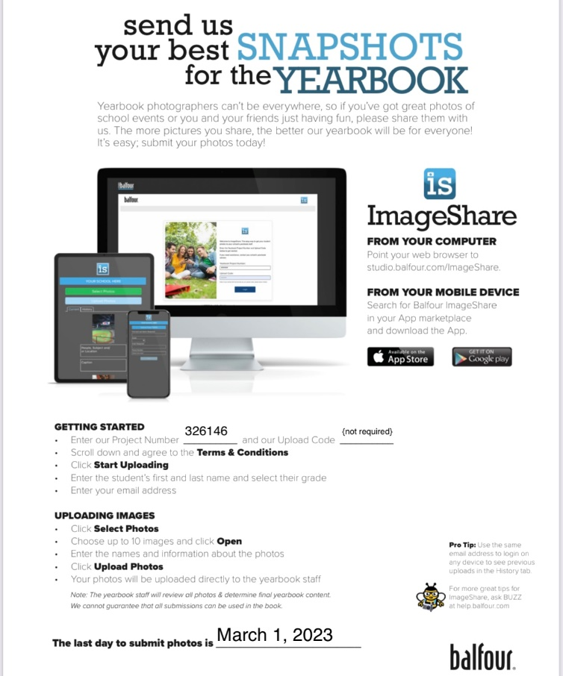
Capture the moments
Yearbook Pictures
All Room Parents are encouraged to capture classroom moments of Dolvin sponsored activities for the yearbook.

Slide 23
Room parent is a PTA supported role! As room parent, it is important that you join the PTA and encourage the other classroom parents to join the PTA as well! At curriculum night, please encourage parents to join the PTA.
HOW YOU CAN SUPPORT THE PTA & YOUR CHILD…..Donate to the Annual Fund online at: https://dolvinpta.membershiptoolkit.com
WHY BE A SUPPORTER………To enhance YOUR child’s academic and social development.
Dolvin PTA spends appx. $150 per child/per year – your donation directly supports many programs & events.
100% of your donation is tax deductible & goes directly to the students.
WHERE DOES YOUR SUPPORT GO……..Academic Enrichment: Dolvin Discovery Lab, International Day, Lunch Bunch, Reflections, Rock’n Reader, $100 per teacher for school materials, Student Agendas
Student Enrichment: Character Education, Spirit Days, School Store, Book fair, Yearbook, Kids Care, Field Day, All Pro Dad
Social & Hospitality Events: Dolvin Family Fun Night, Bingo Night, Math Night, Ice Cream Social, Teacher Appreciation Week, Class Celebrations
Health & Community Outreach: Grounds & Gardening, Hands On Dolvin, Hearing & Vision Screening, Window of Wishes
And so much more!!!!!! Dolvin Elementary PTA is a 501(c)(3) not-for-profit agency. EIN #58-1406389

Slide 24
QUESTIONS??
Email: rtruelove@gmail.com

